Slide 1
Modelling and inversion of electromagnetic data
Lindsey Heagy
University of British Columbia - Geophysical Inversion Facility
January 19, 2025

Slide 2
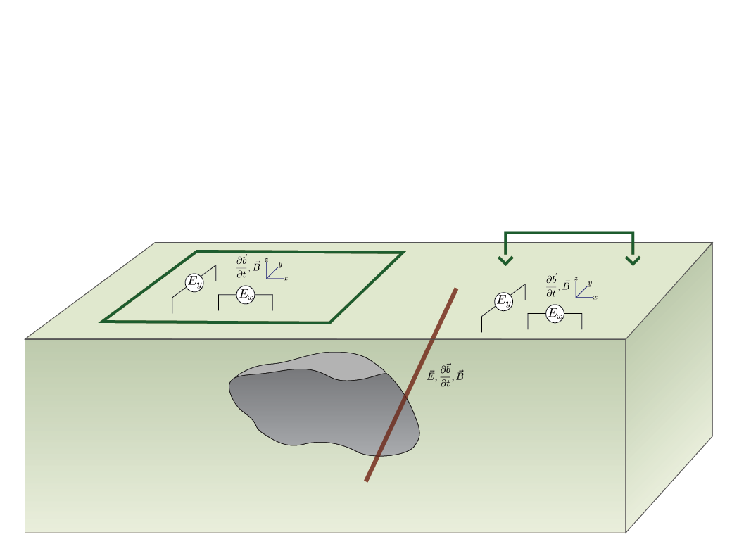
Ground and Borehole EM
setup:
grounded or inductive source
measure E, B, db/dt
x, y, z components
on ground or in boreholes

Slide 3
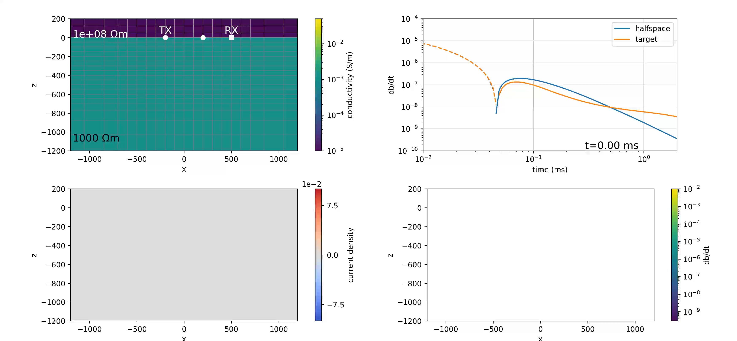
Inductive source time domain response

Slide 4
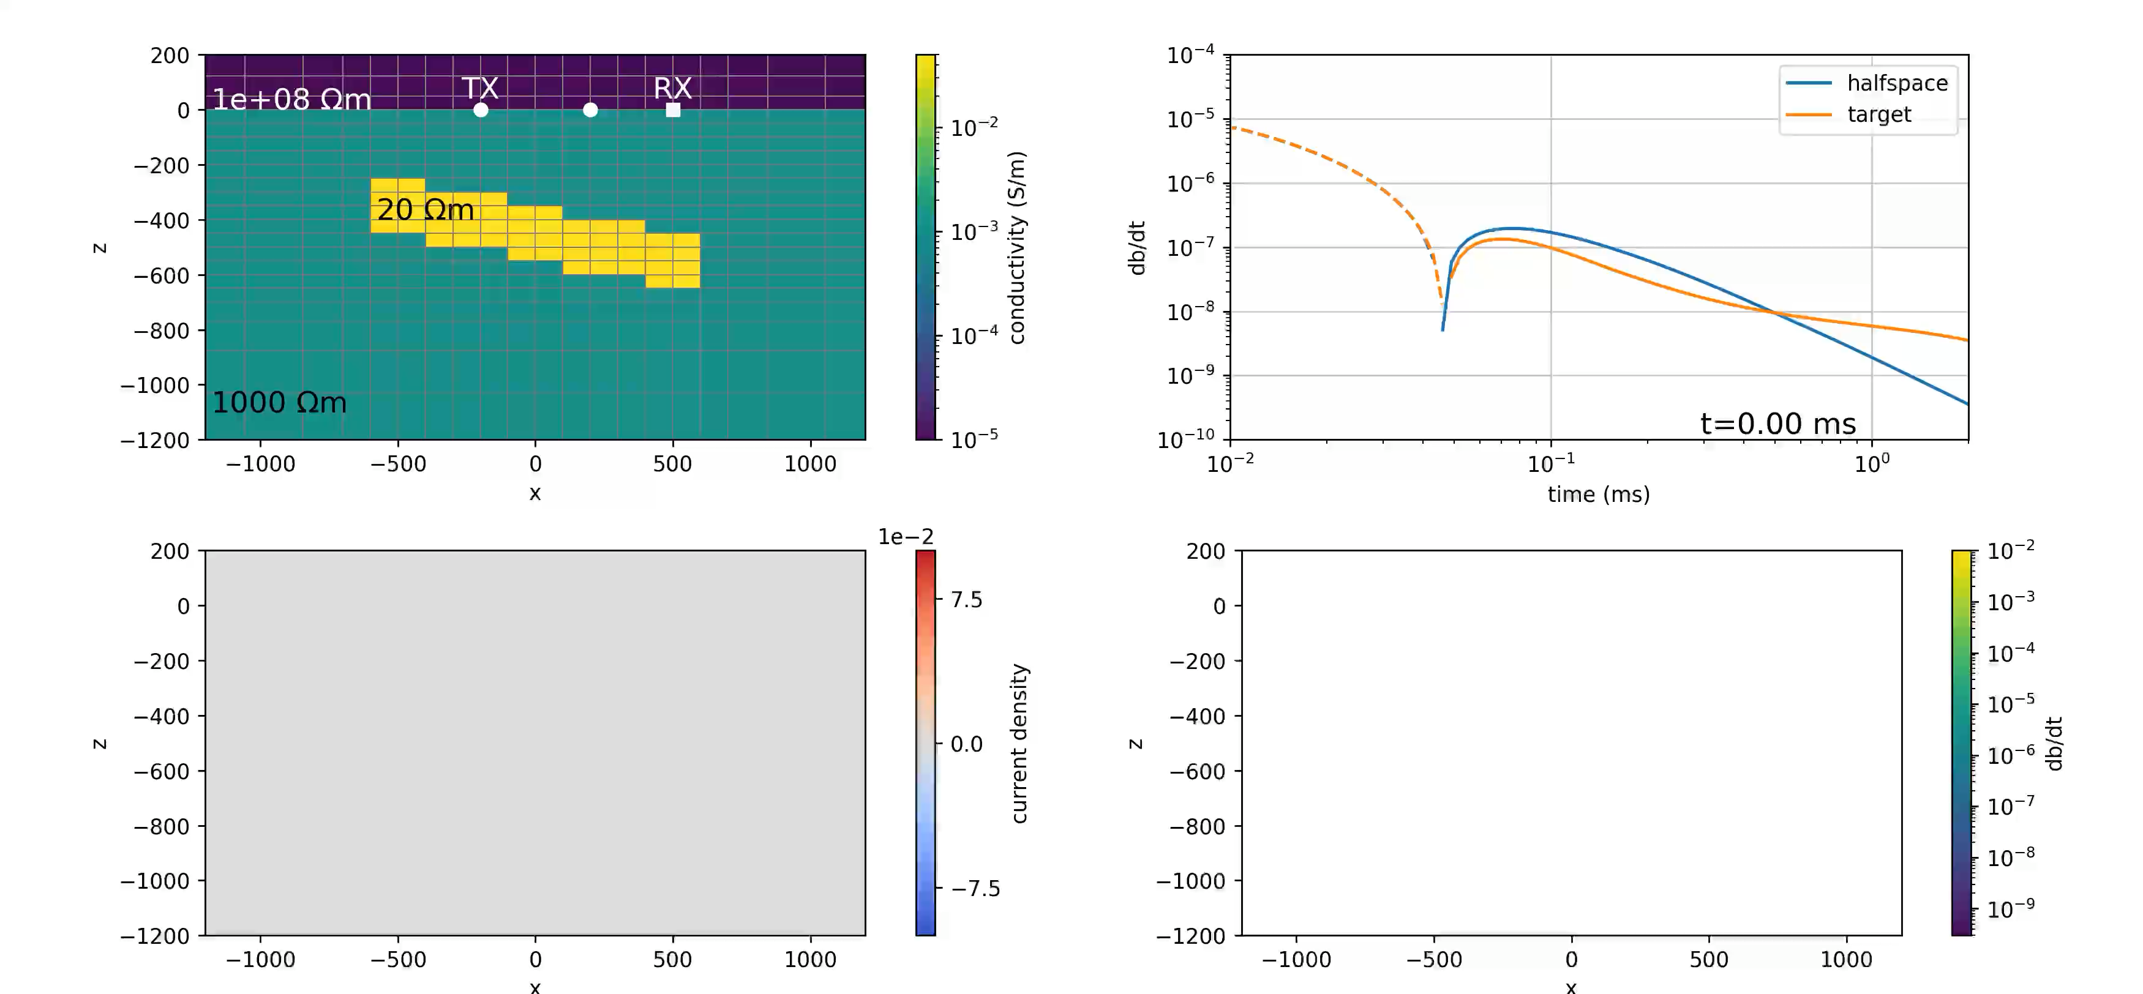
Inductive source time domain response

Slide 5
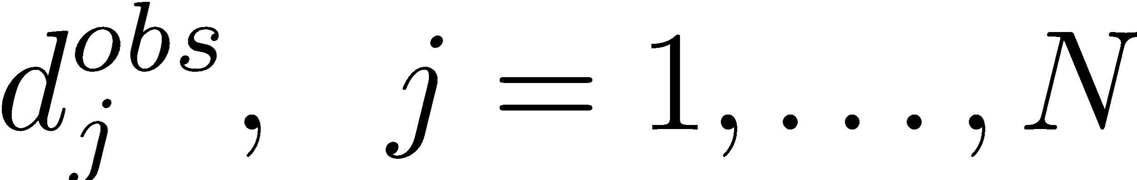
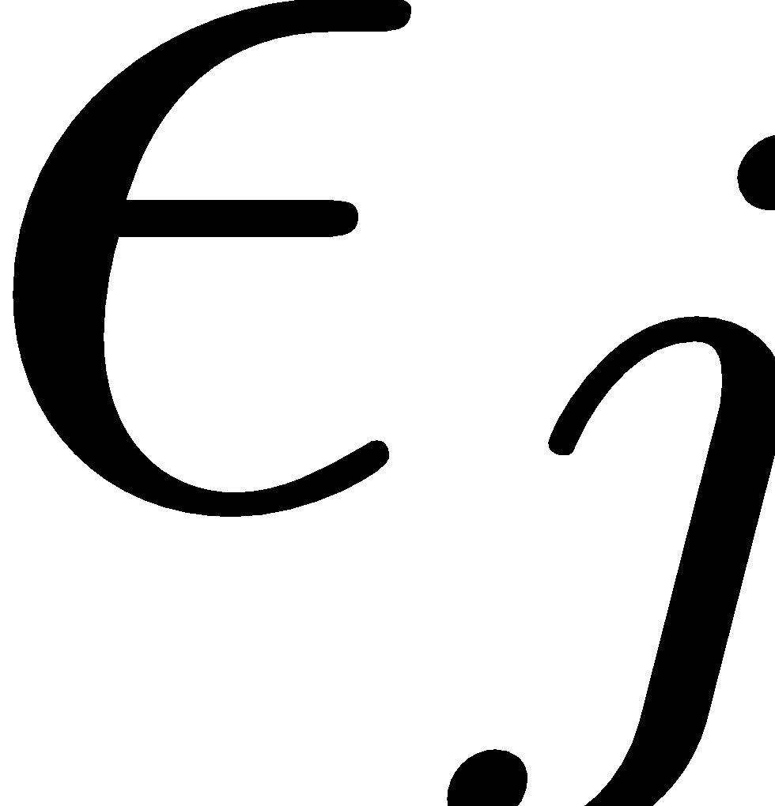
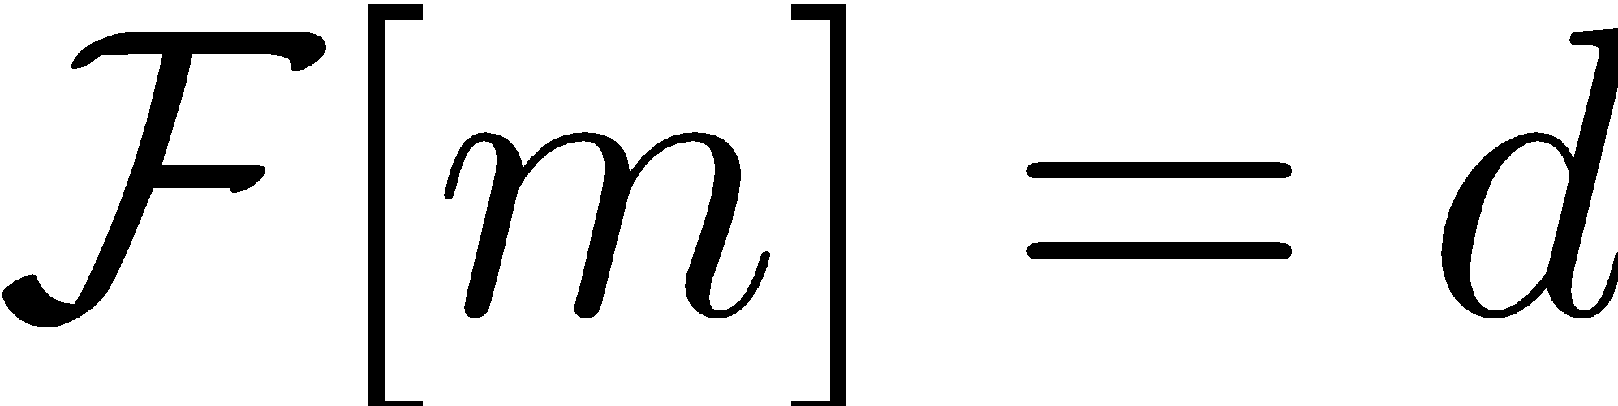
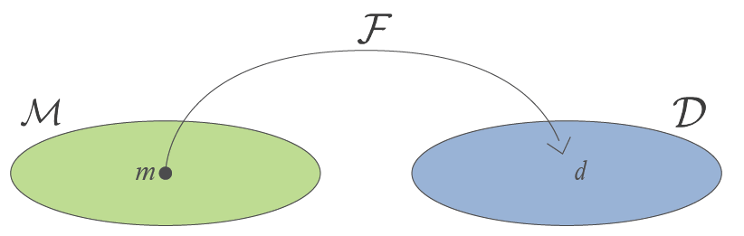
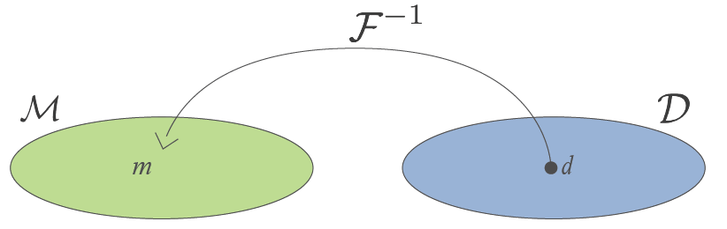
Statement of the inverse problem
Given
observations:
uncertainties:
ability to forward model:
Find the Earth model that gave rise to the data

Slide 6
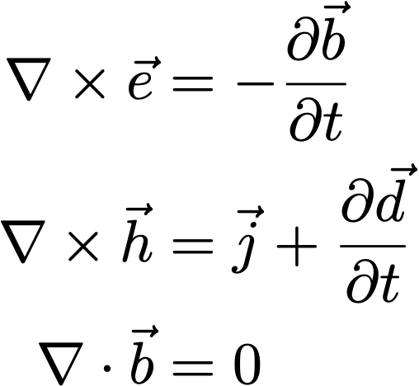
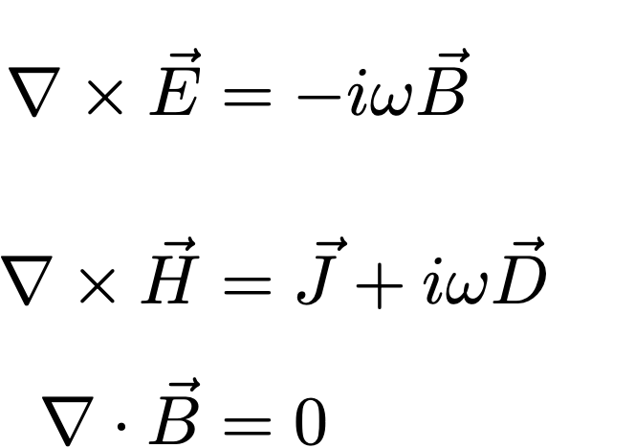
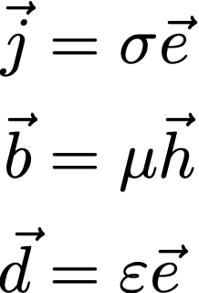
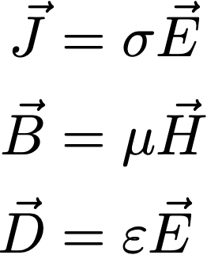
Electromagnetics: basic equations (quasi-static)
Time
Frequency
Faraday’s Law
Ampere’s Law
No Magnetic Monopoles
Constitutive
Relationships
(non-dispersive)
* Solve with sources and boundary conditions

Slide 7
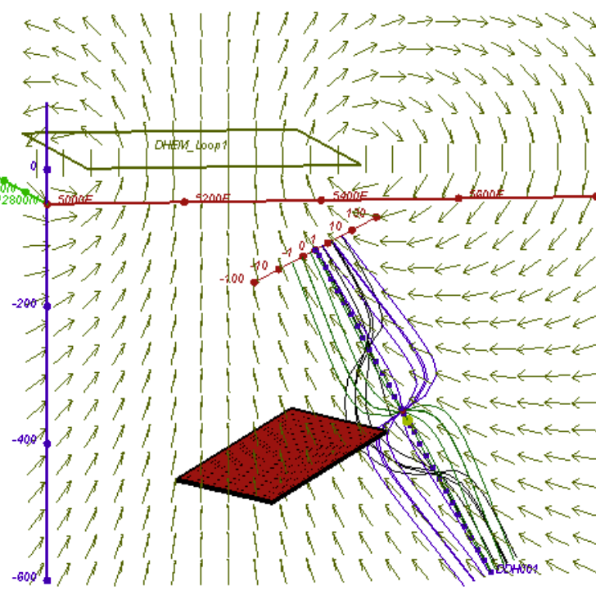
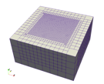
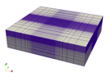
Forward modelling
Lots of choices…
plate modelling, 1D, cylindrically symmetric, 3D
time or frequency
different mesh choices
structured
semi-structured (e.g. OcTree)
unstructured (e.g. tetrahedral)
discretization strategy
integral equation
finite difference
finite volume
finite element
plate modelling
3D tensor
3D OcTree

Slide 8
Forward modelling
Our focus today
plate modelling, 1D, cylindrically symmetric, 3D
time or frequency
different mesh choices
structured
semi-structured (e.g. OcTree)
unstructured (e.g. tetrahedral)
discretization strategy
integral equation
finite difference
finite volume
finite element
plate modelling
3D tensor
3D OcTree

Slide 9
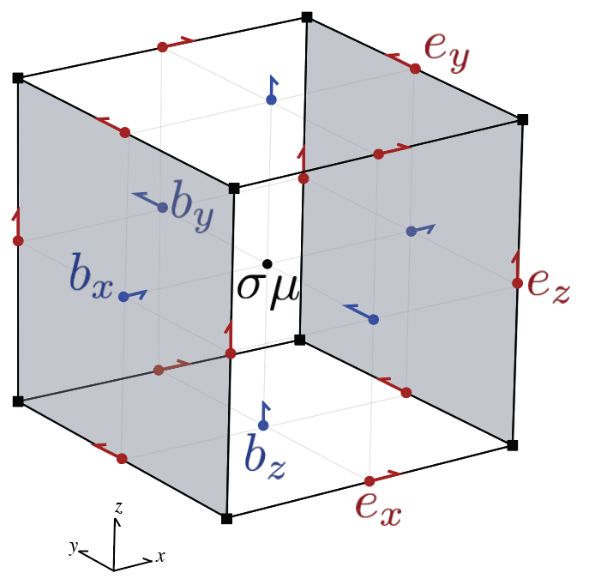
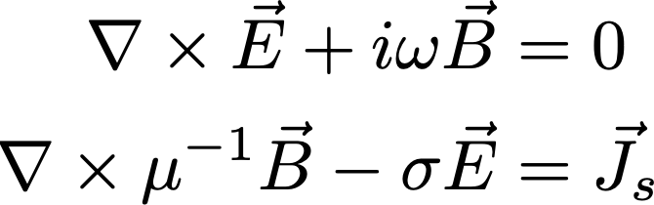
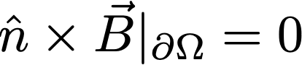
Solving the frequency domain equations
Use constitutive relations, reduce to two equations, one field, one flux
Boundary conditions
Staggered grid discretization
Physical properties: cell centers
Fields: edges
Fluxes: faces

Slide 10
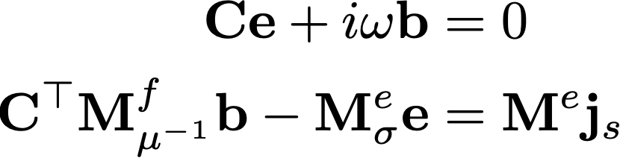
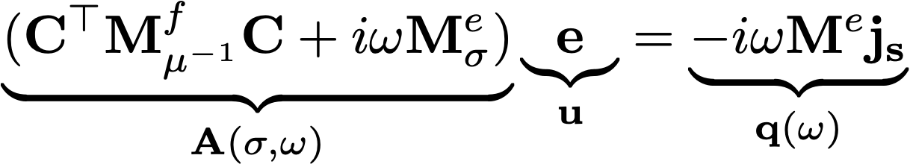
Solving the frequency domain equations
Discrete equations
Eliminate b to obtain a second-order system in e

Slide 11
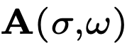
Solving the frequency domain equations
Complex
Symmetric
Factor once for each frequency (solve for multiple sources)
Need to refactor on each model update
Separable over frequencies

Slide 12
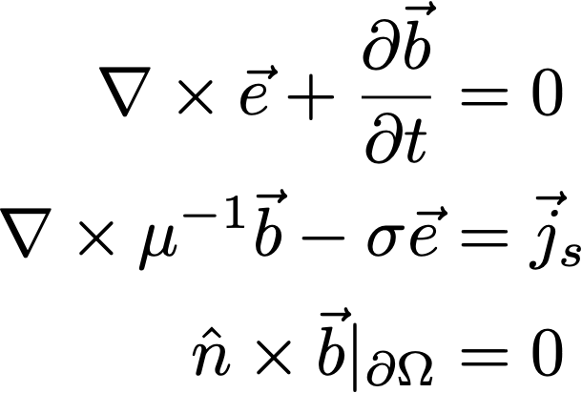
Solving the time domain equations
Use constitutive relations, reduce to two equations, one field, one flux
Boundary conditions
Staggered grid discretization
Physical properties: cell centers
Fields: edges
Fluxes: faces

Slide 13
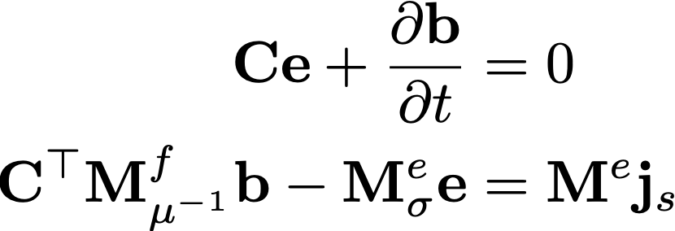
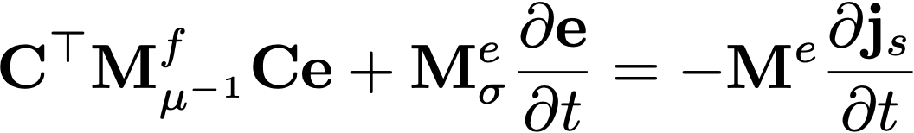
Solving the time domain equations
Semi-discretization in space
combine into a single, second order equation in e
to solve, need to discretize in time…

Slide 14
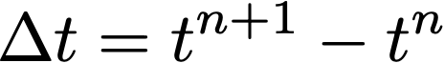
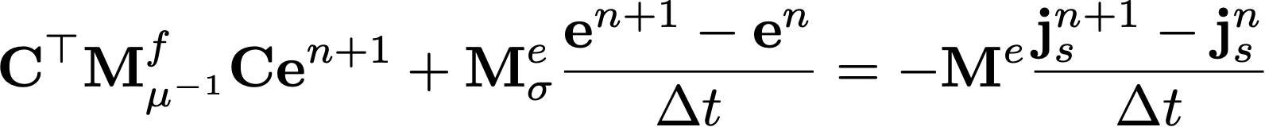
Solving the time domain equations
First order backward difference (backward euler)
depends upon
Time step:
Rearrange to solve for

Slide 15
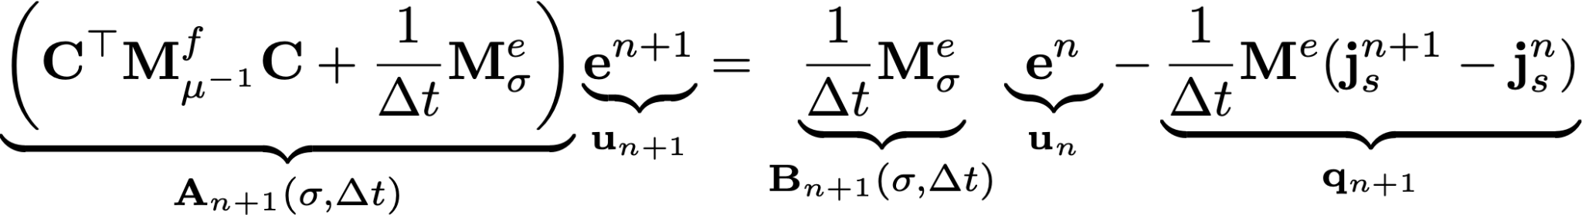
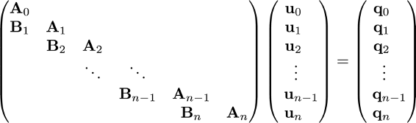
Solving the time domain equations
Discrete equations
Arrange in a big matrix to solve

Slide 16
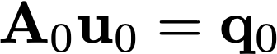
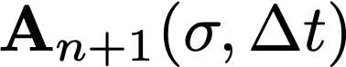
Solving the time domain equations
Solve with forward substitution
Solve initial conditions for
Propagate forward by solving
Symmetric
Need to solve many times
Only changes if changes → store factors & re-use

Slide 17
Frequency and Time domain simulations
Frequency
Complex, symmetric
Factor for each frequency
Inversion: sensitivity derivation straight-forward
Time
Real, symmetric
Factor for each unique
Inversion: sensitivity derivation more involved

Slide 18
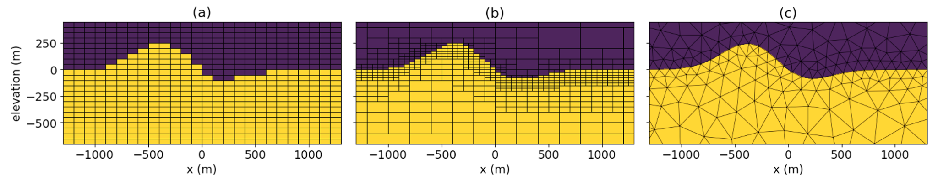
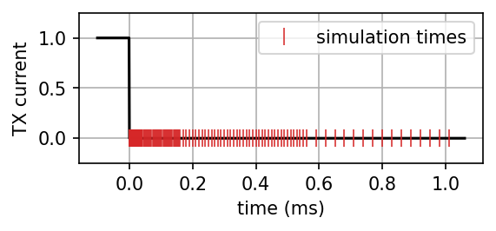
Setting up a forward simulation & user decisions
Mesh design
minimum cell size
capture shortest time / highest frequency, highest conductivity
domain extent
beyond skin depth / diffusion distance
Time discretization
capture short-timescale variations near shut-off
needs to be finer than receiver times
extend to latest time channel
trade-off between computation cost and accuracy

Slide 19
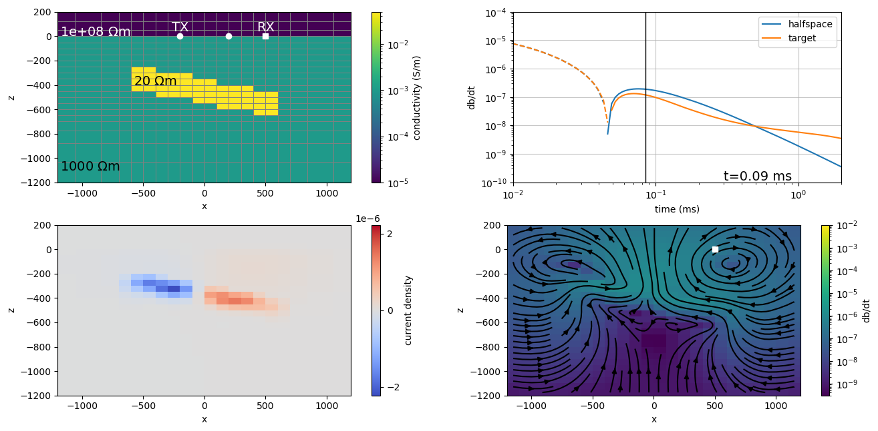
Forward modelling can address
Survey design:
source: coupling? base frequency?
receivers: best to measure e, b, db/dt?
Complexities:
overburden
multiple targets, interactions?
Value in looking at:
currents, magnetic field
and simulated data

Slide 20
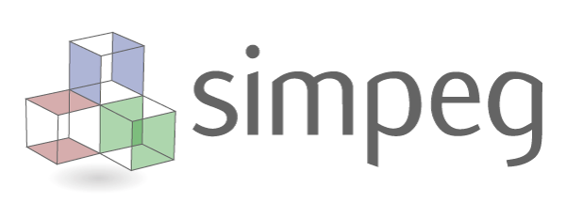
Practical notes
Computational time for this example
Tensor Mesh with…
62,000 cells
170 time steps, 4 unique Δt
1 source
→ Forward simulation time: 57s
Refine the mesh (~double number of cells)
128,000 cells
same time stepping
→ Forward simulation time: 136s

Slide 21
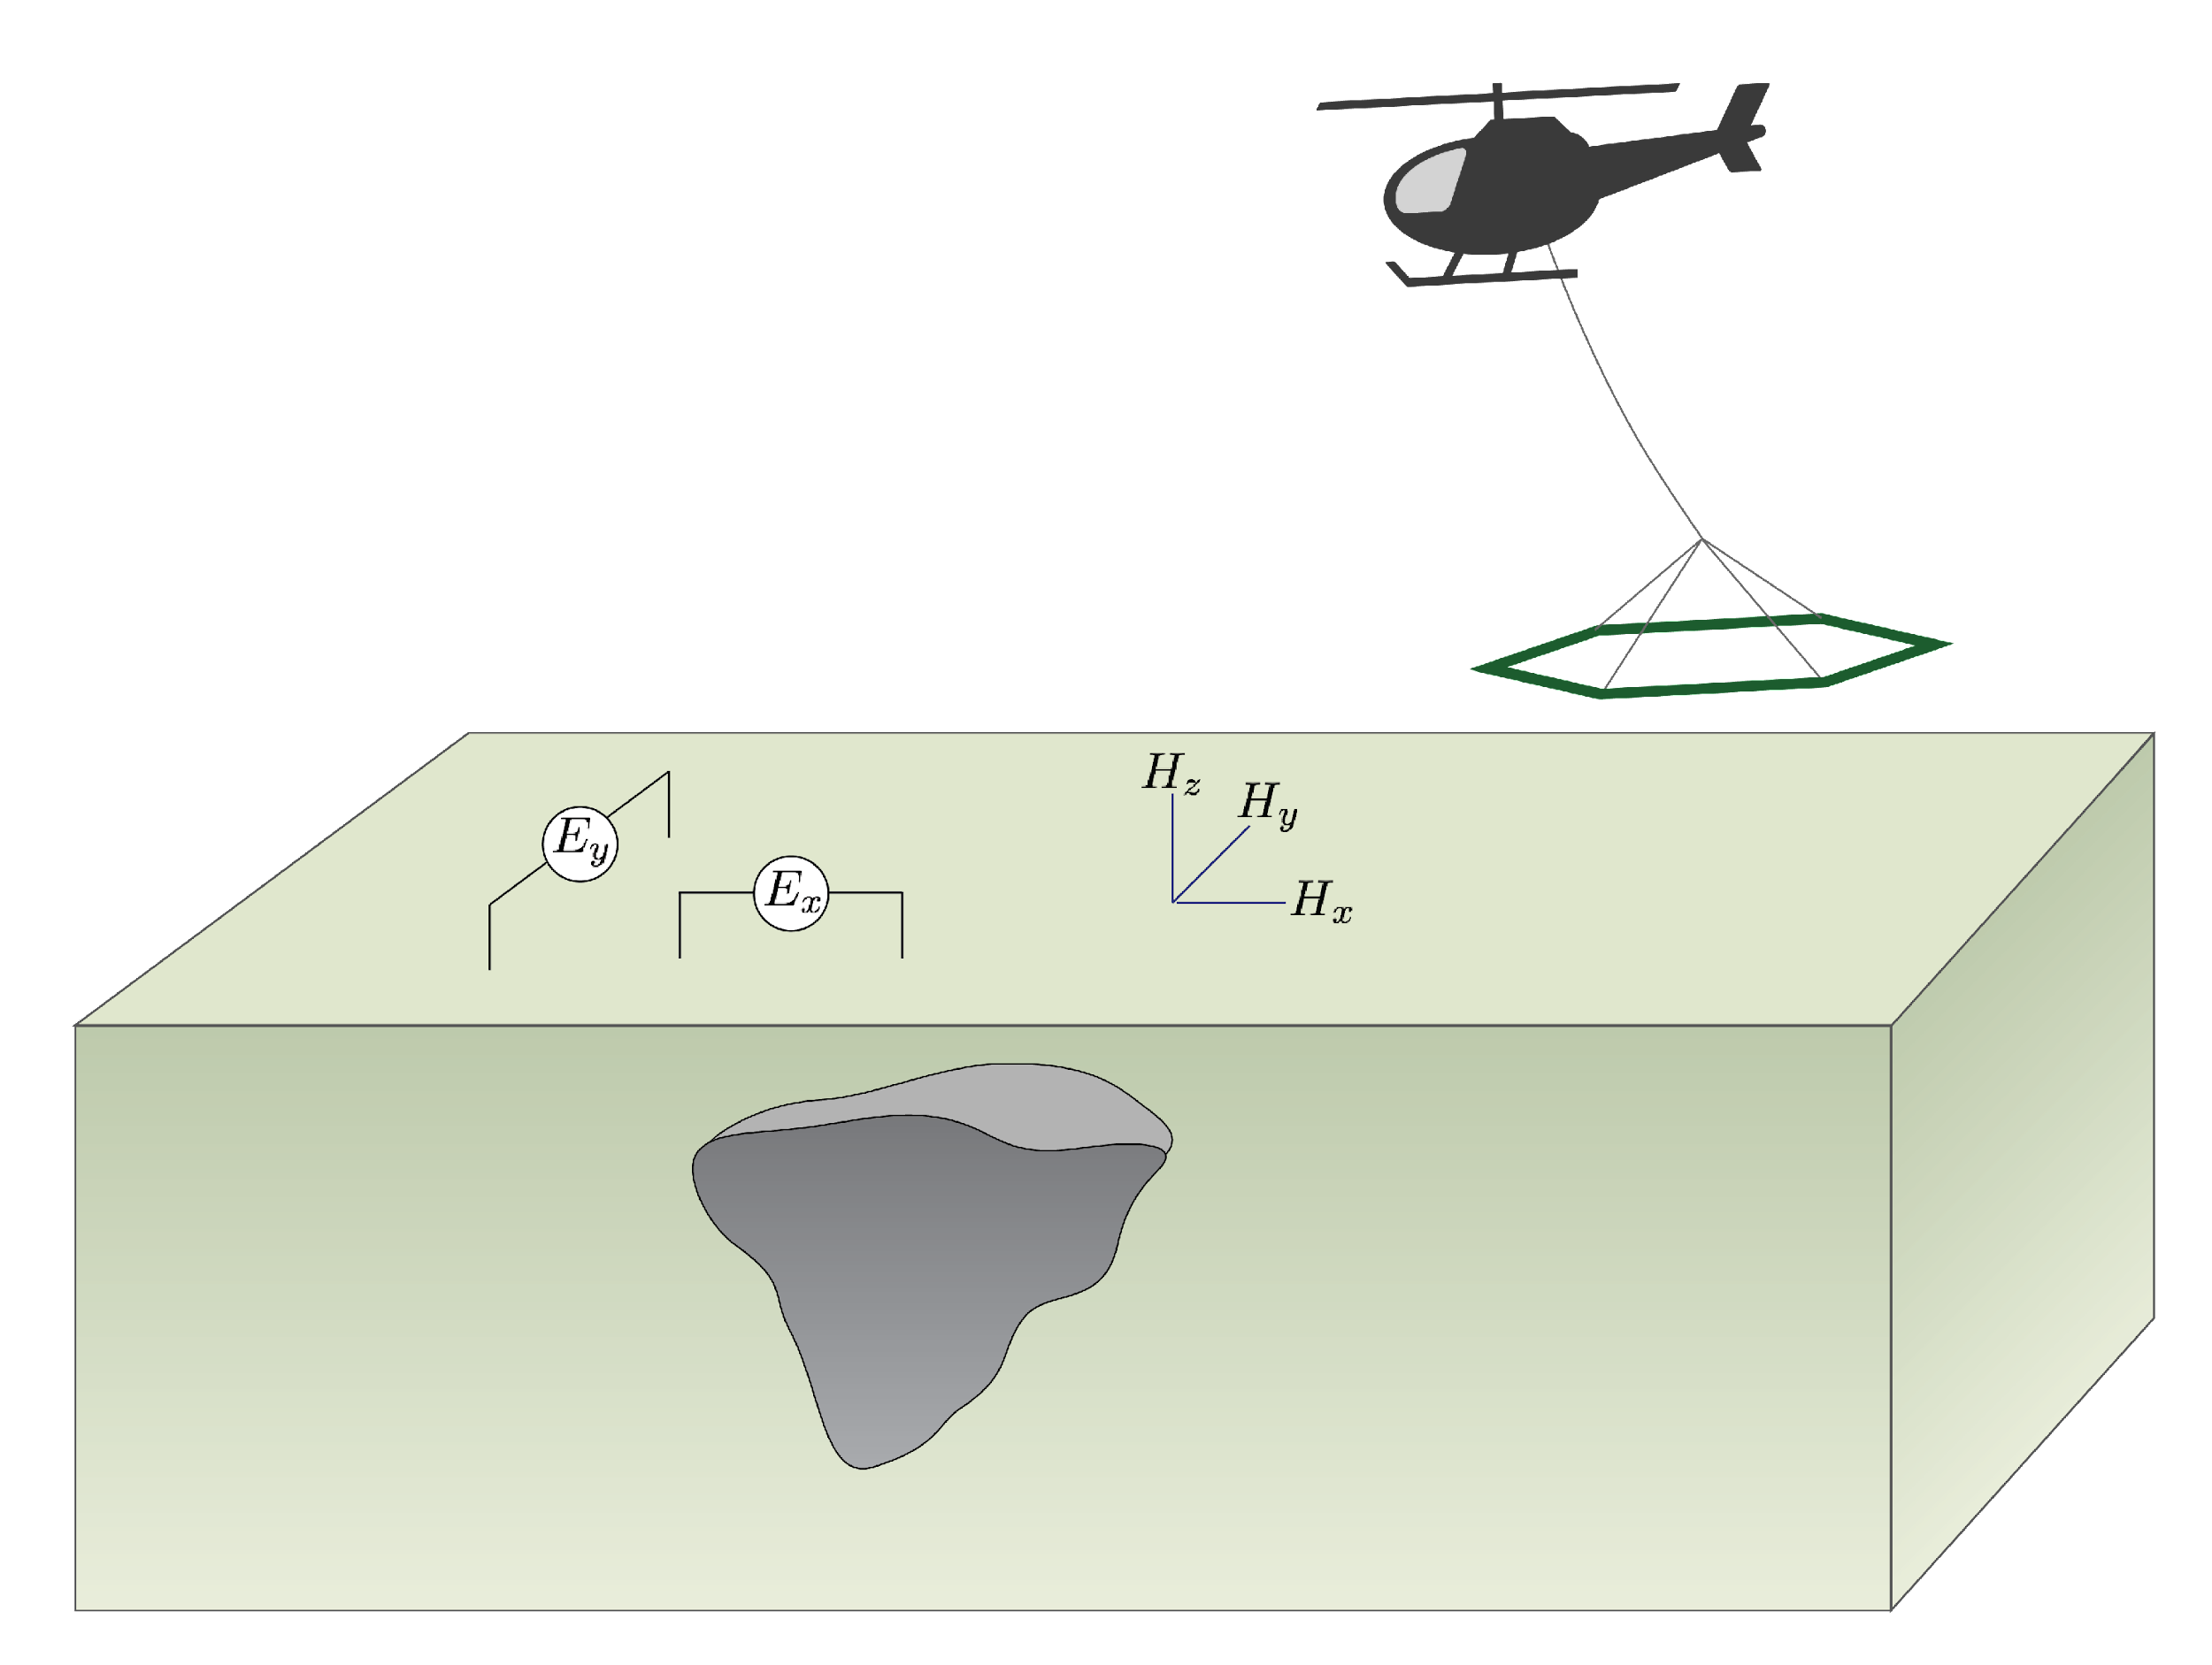
Statement of the inverse problem
Given
observations:
uncertainties:
ability to forward model:
Find the Earth model that gave rise to the data

Slide 22

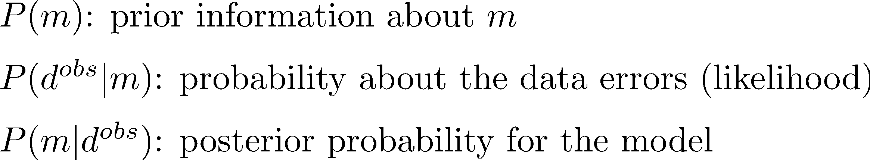
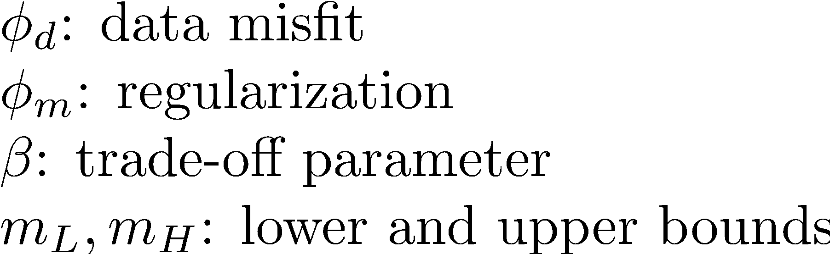
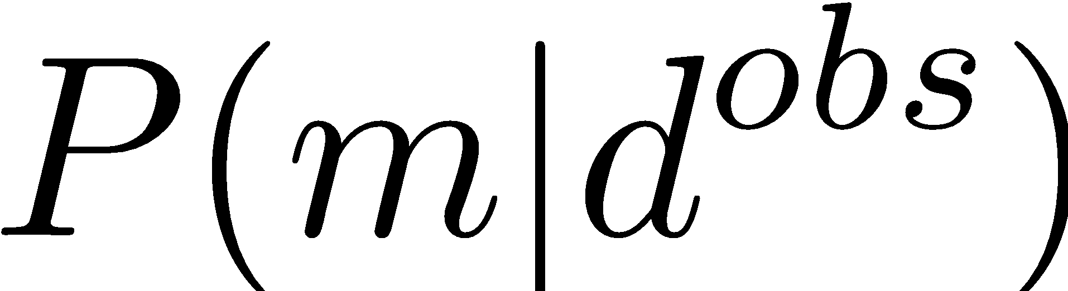
Need a framework for inverse problem
Tikhonov (deterministic)
Bayesian (probabilistic)
Find a single “best” solution by solving optimization
Use Bayes’ theorem
Two approaches:
Characterize
Find a particular solution that
maximizes
MAP: (maximum a posteriori) estimate
Notes:
Likelihood of data

Slide 23
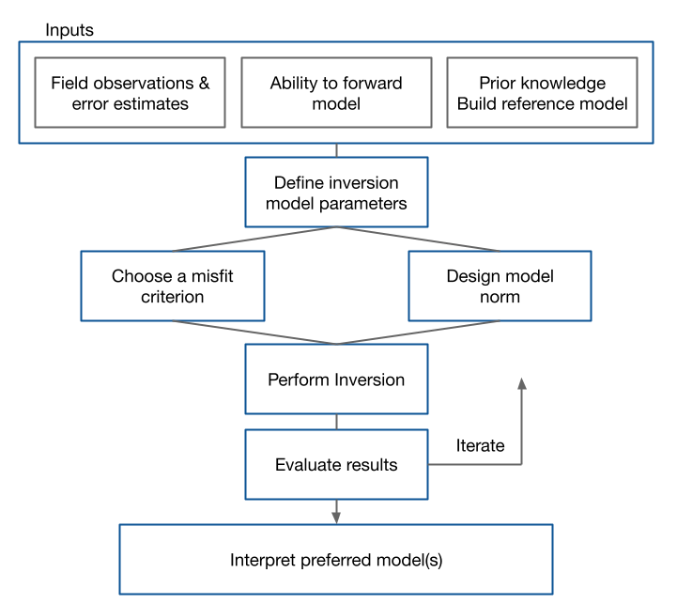
Flow chart for the inverse problem
What do we need for inversion?
From the simulation
adjoint sensitivity times a vector
sensitivity times a vector
Inversion components:
define a model norm
perform optimization

Slide 24
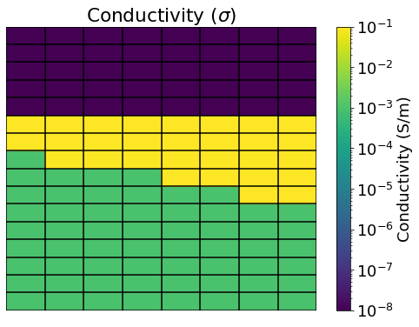
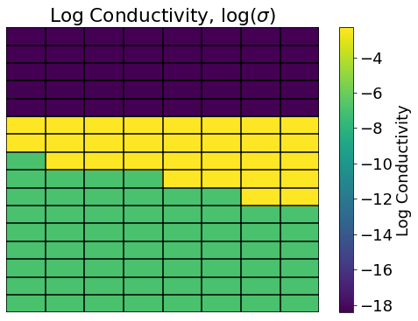
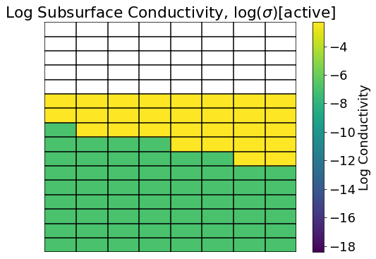
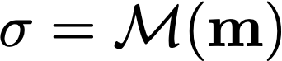
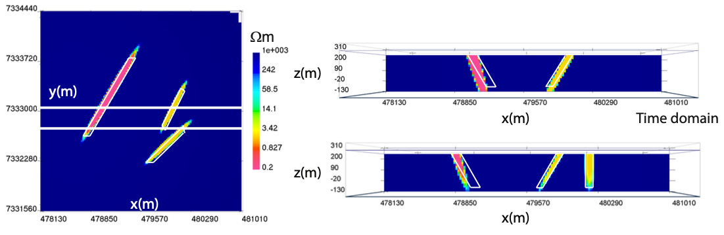
Defining the model model parameters
typically log conductivity below the surface of the earth
can also work with parametric models (e.g. ellipsoids)
McMillan et al., 2017

Slide 25
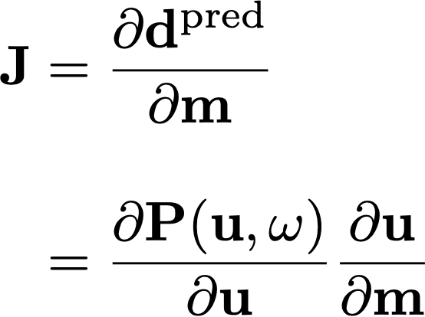
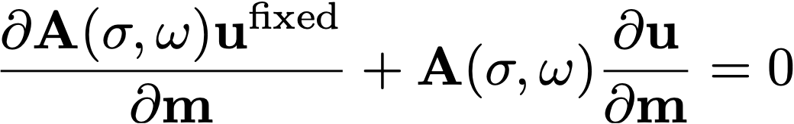
Sensitivities
For inverse problem, also need sensitivities (and adjoint)
where the derivative of the fields (u) is computed implicitly (requires a solve)
J is a large, dense matrix → compute products with a vector if memory-limited
Notes:
(and put some numbers? say you have 1 M cell and 100,000 datum, then the size of the matrix 0.1M x 1M = 100B)

Slide 26
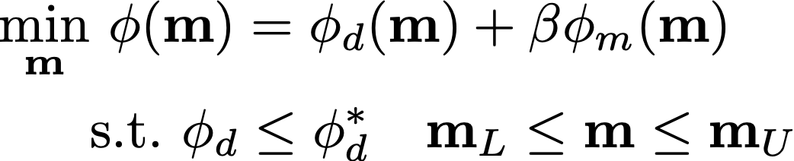
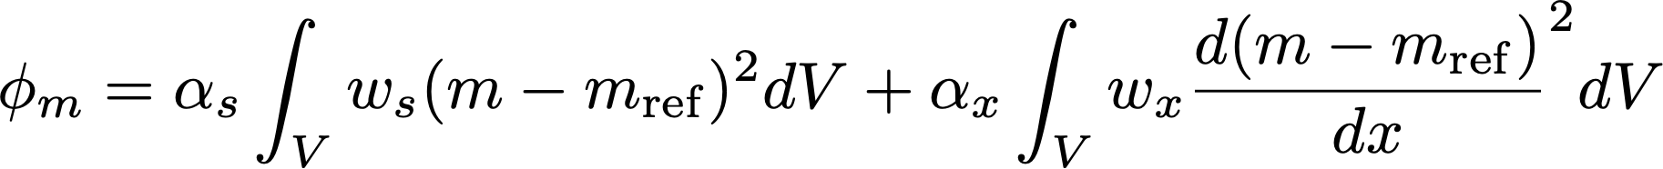
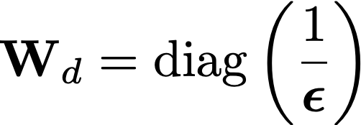
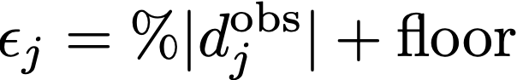
Inversion as an optimization problem
data misfit
model norm (L2)
uncertainties captured in W
smallness
smoothness
discretize

Slide 27





Gauss Newton approach
Gradient
Taylor expand → Gauss newton equations (solve with CG)
Sensitivity (J) requires forward modelling
large, dense matrix (expensive to store)
compute matrix-vector products when memory-limited

Slide 28


Practical notes
One inversion iteration requires we solve:
Number of forward calculations per iteration:
62,000 cells ~ 57s
Total computation time:
~10
~20
~1 min (small prob)
~3.5 hours

Slide 29
3D inversions with EM
Challenges: computational cost
need many forward simulations to run an inversion
Non-uniqueness
all inversions non-unique
impacted by survey geometry
Role of a-priori information
reference models
model parameterization
…

Slide 30



Research avenues
3D inversion with highly conductive targets
Challenging sensitivities, modelling
Role for parametric inversions
Incorporating in a-priori information
Different norms in the regularization
Petrophysically and Geologically guided inversions (PGI)
Opportunities for machine learning

Slide 31

SimPEG
forward simulation and inversion tools
frequency and time
1D, 3D, cylindrically symmetric
inversions
standard L2
different norms, PGI
parametric approaches
https://simpeg.xyz

Slide 32



Resources
GIF tools cookbook
SimPEG user tutorials
Comprehensive workflows
SimPEG user tutorials
https://giftoolscookbook.readthedocs.io
https://simpeg.xyz/user-tutorials

Slide 33


Thank you!
lheagy@eoas.ubc.ca

